Slide 1


Electromagnetism

Slide 2
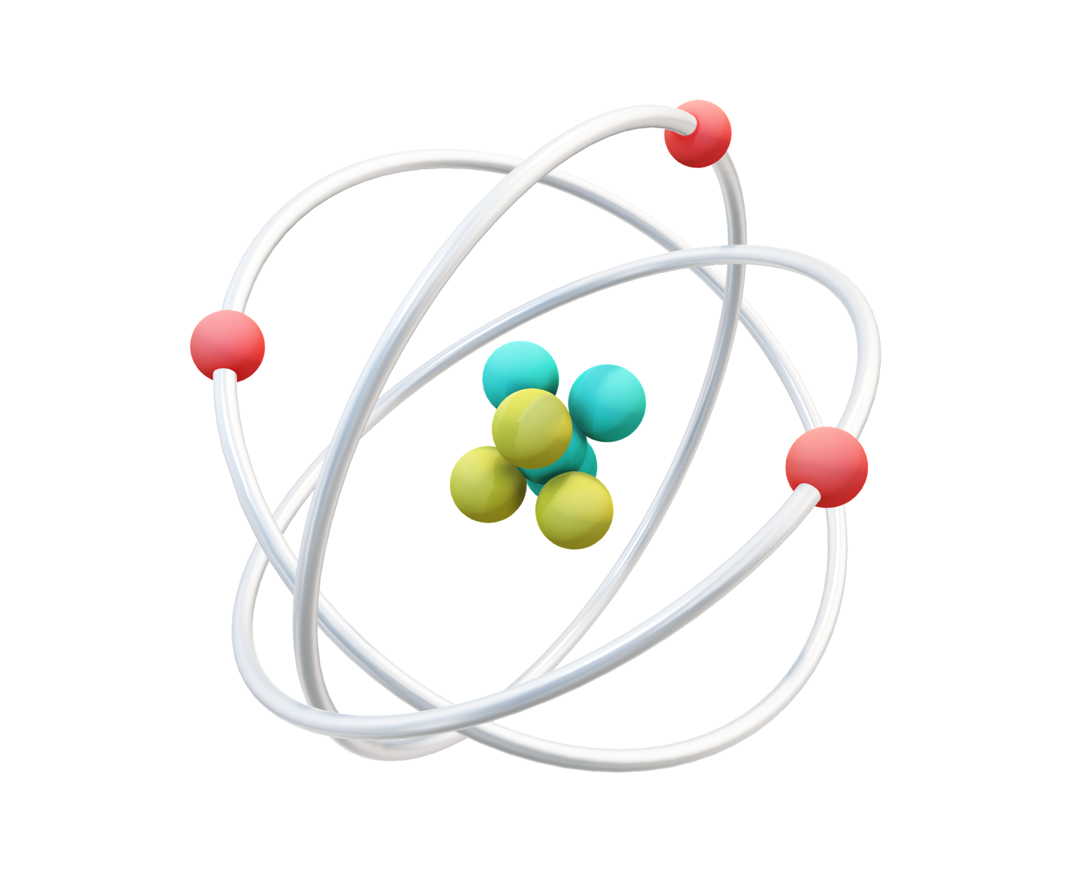
Electrons

Slide 3
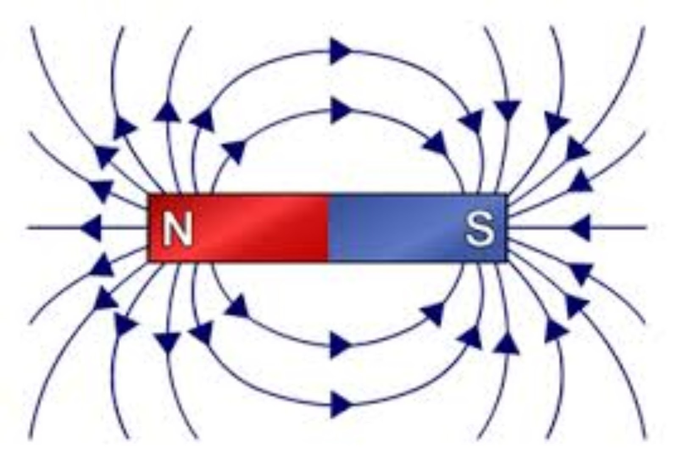
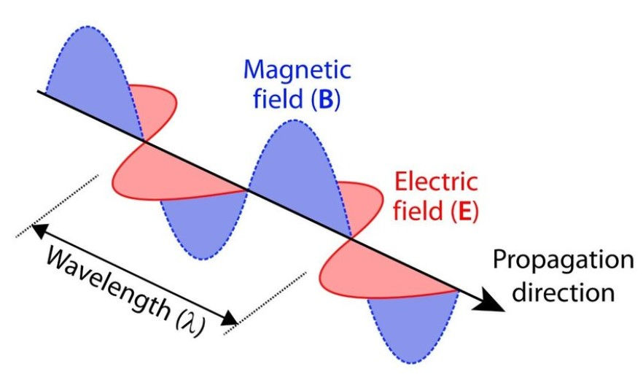
Magnetic Fields

Slide 4
Electricity & Magnets
Principles of Electromagnetism

Slide 5
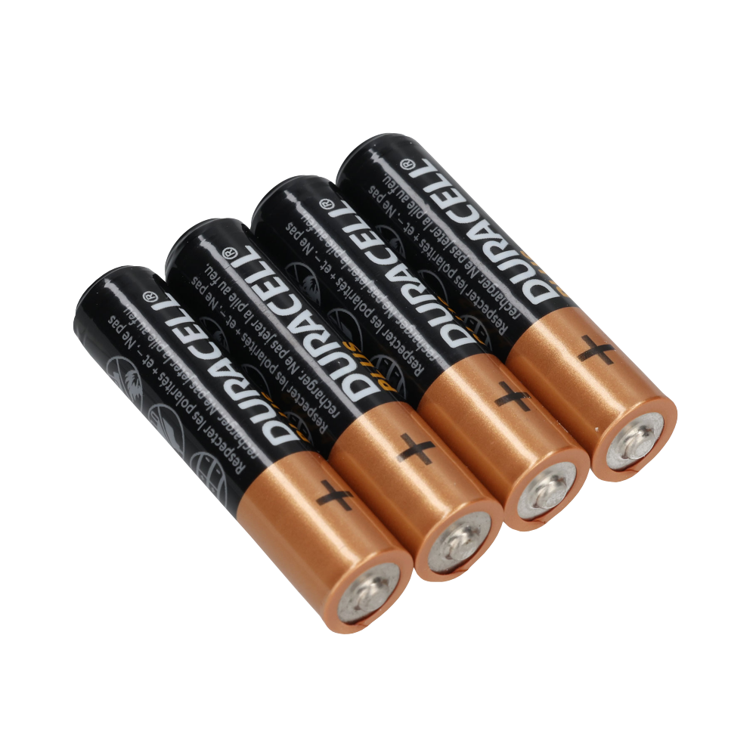
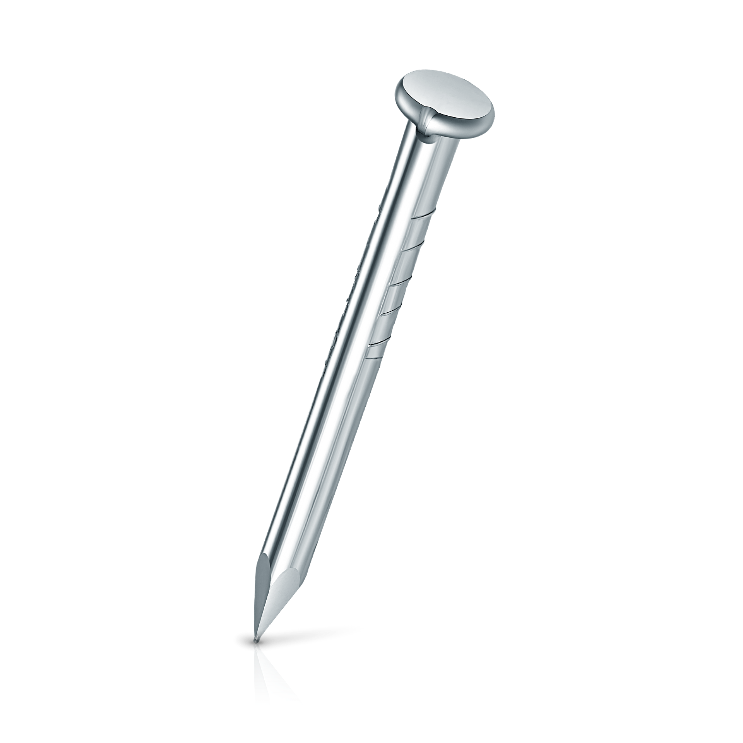
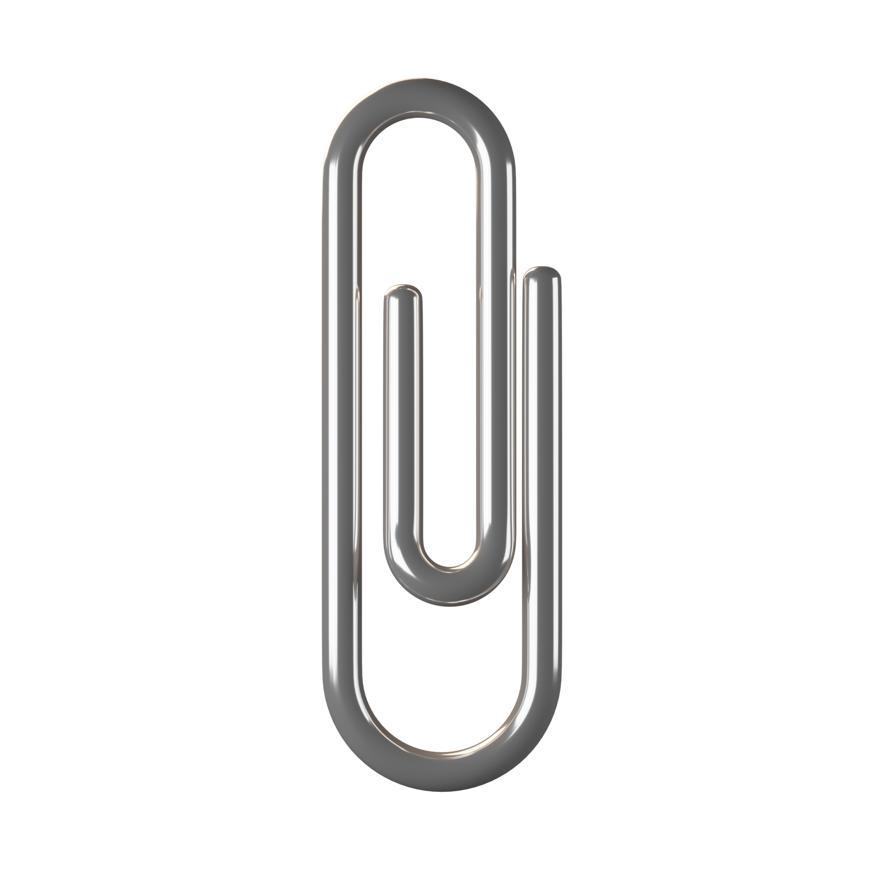
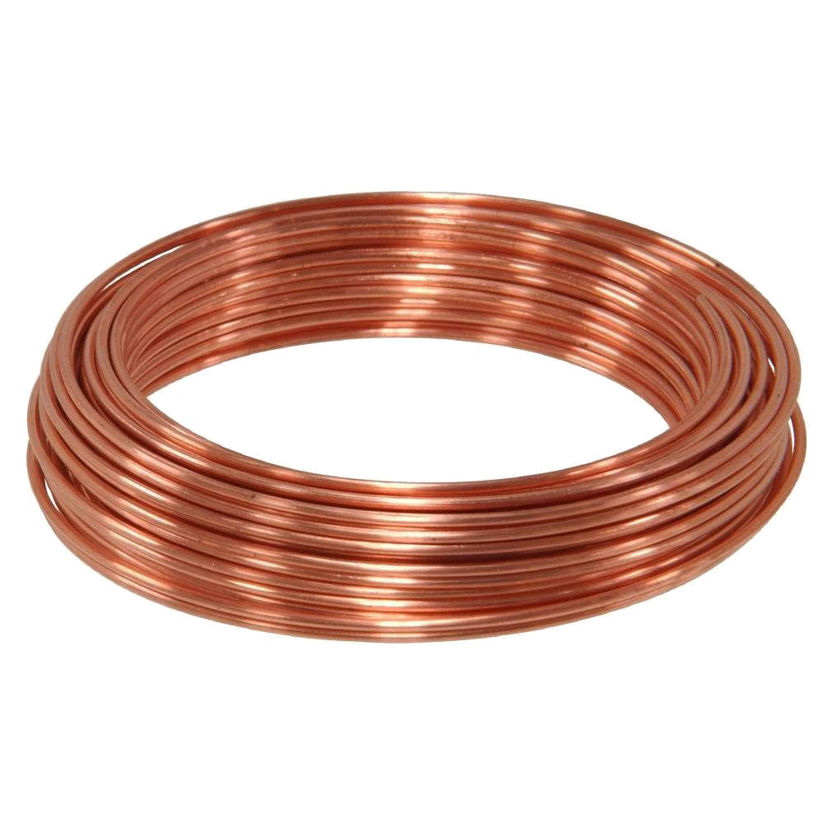

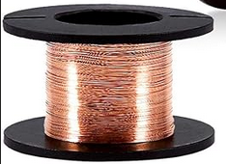
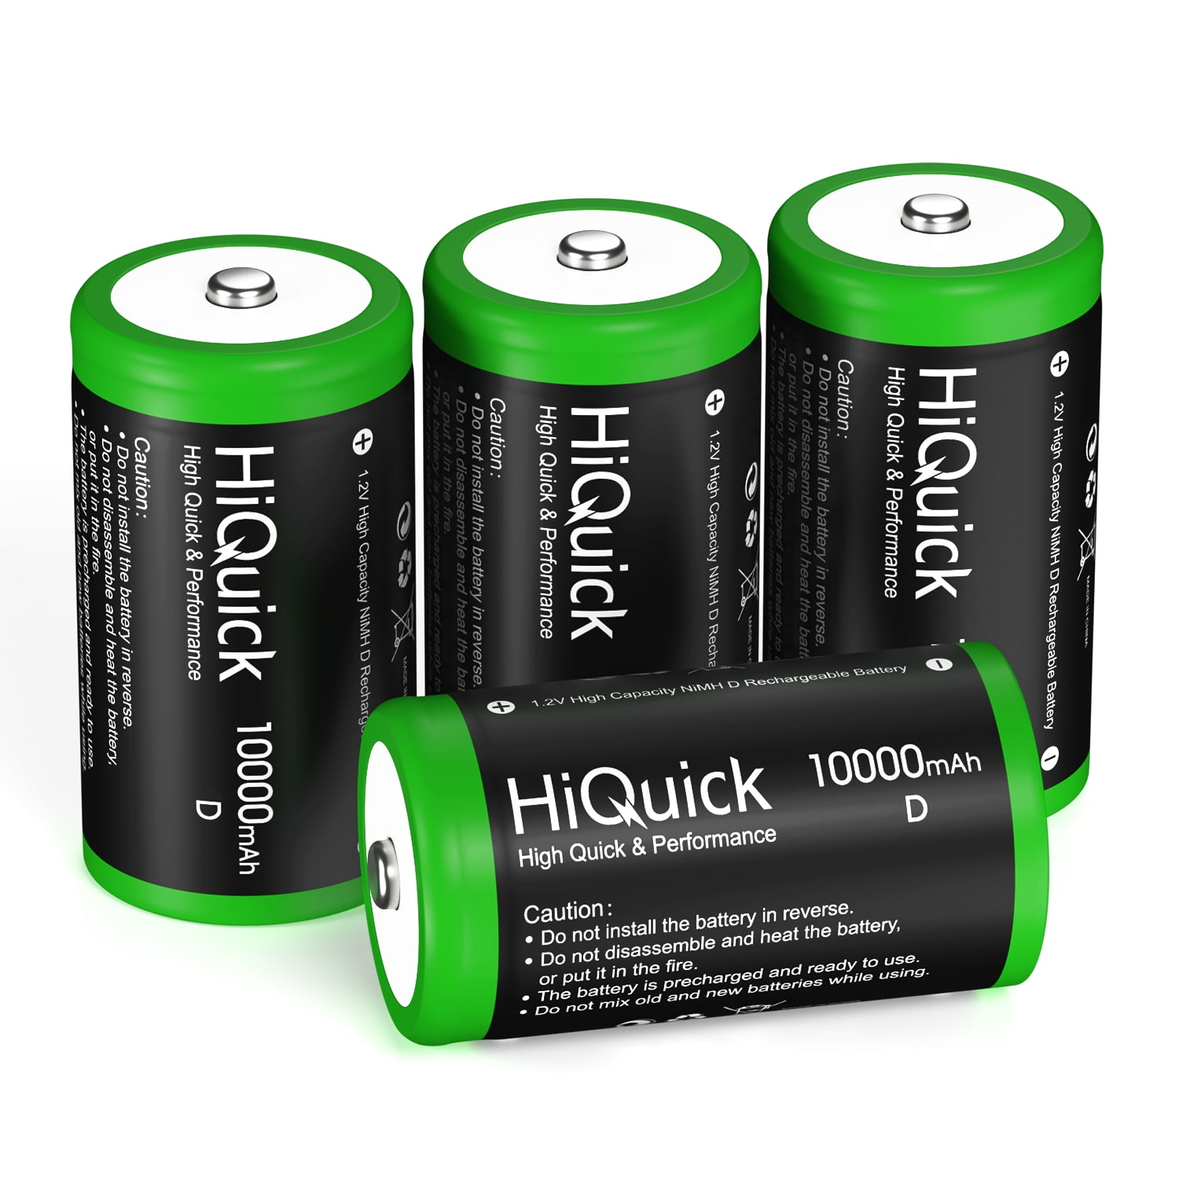
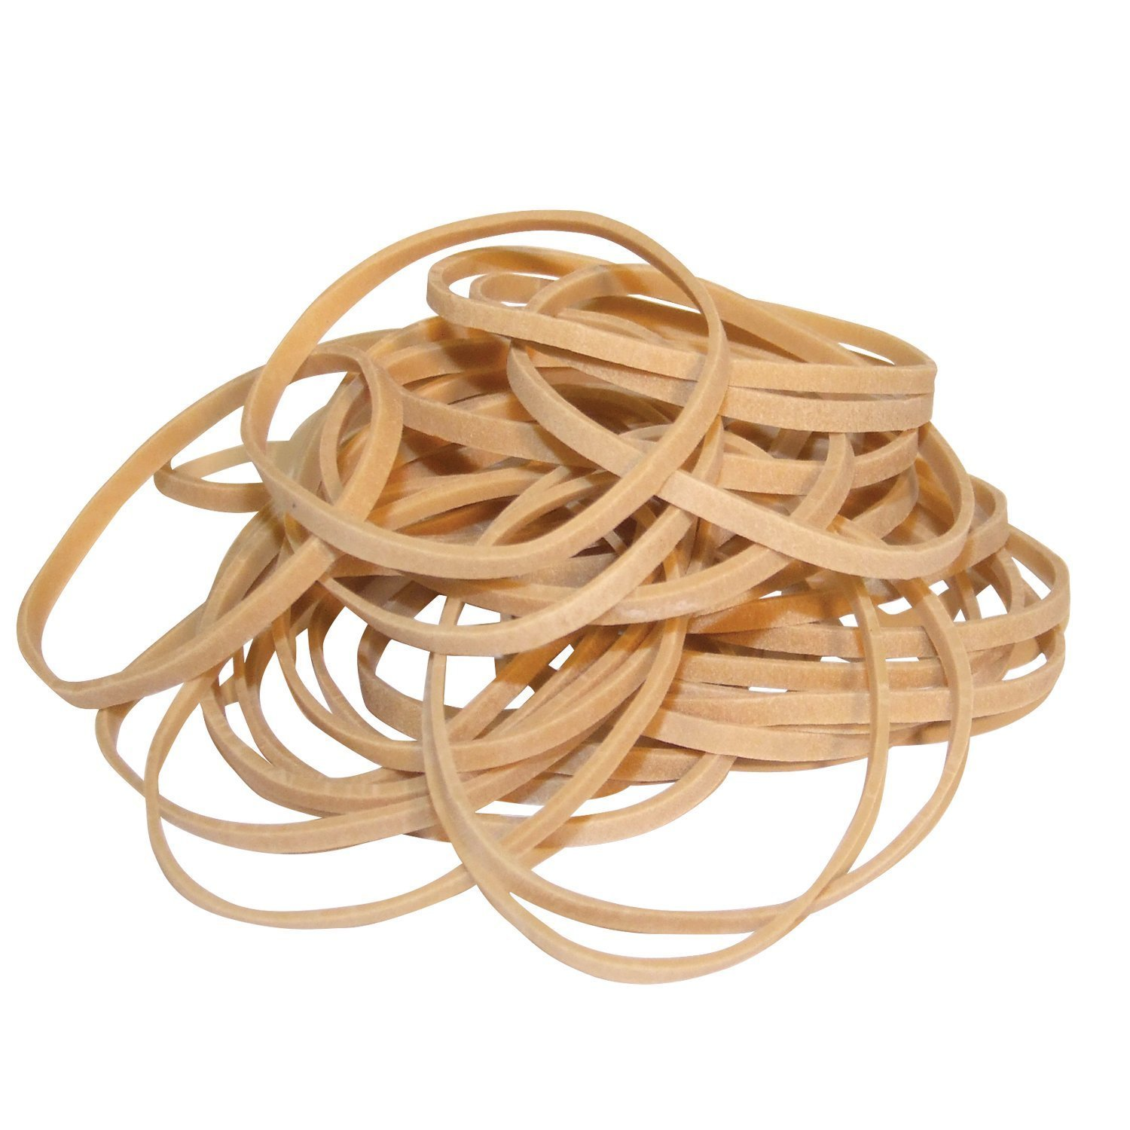
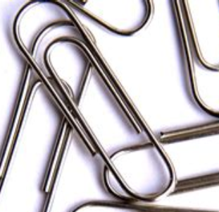
Materials
Iron Nails
Enameled Copper Wire
Battery (AA)
Paper Clips

Slide 6
Let’s Make Electromagnets

Slide 7
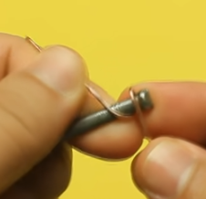
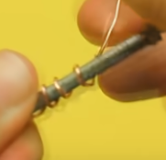
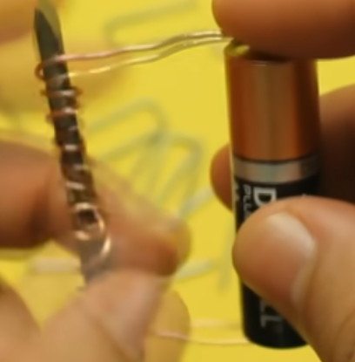
Wrap n’ Connect
Take a nail and copper and wrap
The more turns, the stronger!
Connect one end to the opposite ends of the battery

Slide 8
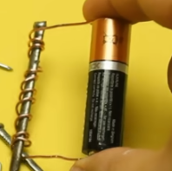
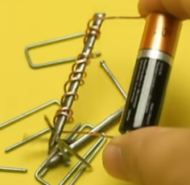
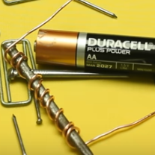
Take n’ Collect
Firmly hold the ends of the wire to the ends of the battery
Hover over some metal objects and collect!
‘Break’ the circuit to turn off the magnet

Slide 9
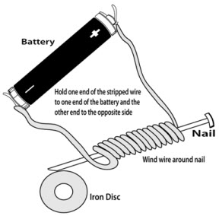
BUT HOW
Iron has unpaired electrons that create small magnetic fields, but are randomly arranged
When connecting the iron to the battery, we allow electrical currents flow in the nail
The electrical currents help the magnetic fields align, creating an electromagnet

Slide 10
Lenz’s Law

Slide 11
Magnetic fields
(Lenz’s Law)

Slide 12
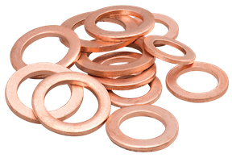
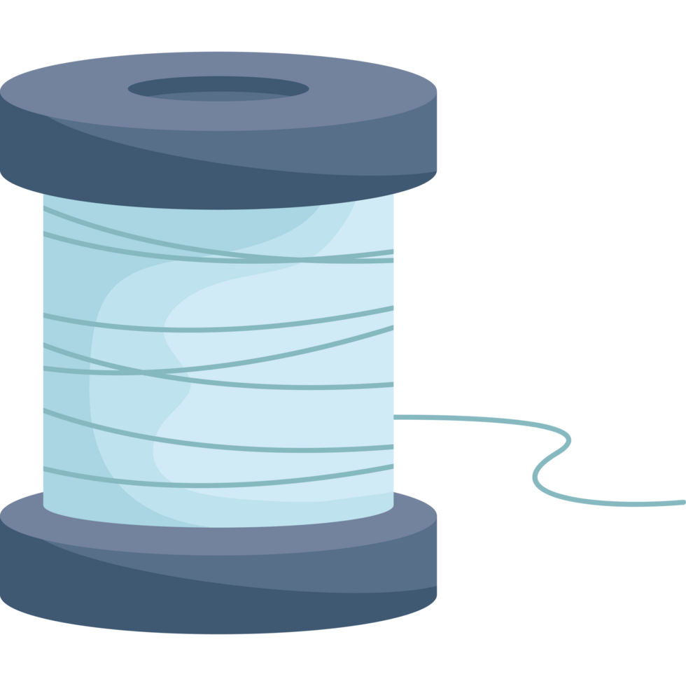
Materials
Fishing Line
Copper Washers
Washer hangers

Slide 13
Why does only one washer move?
As you move the magnet’s field closer, the washer’s magnetic field gets stronger
This changing magnetic field induces an electric current throughout the washer which creates a magnetic field

Slide 14
Why does only one washer move?
When magnet moves closer, this field pushes washer awau
This force is what causes it to move
The cut washer doesn’t have a complete loop, thus no current, and no induced magnetic field forms

Slide 15
DC Motors
How electromagnetism creates motion

Slide 16
How about some action?

Slide 17
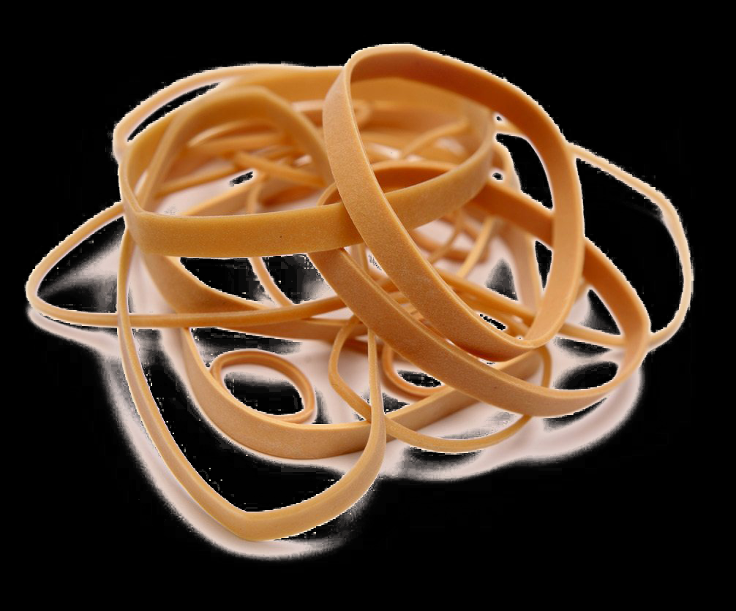
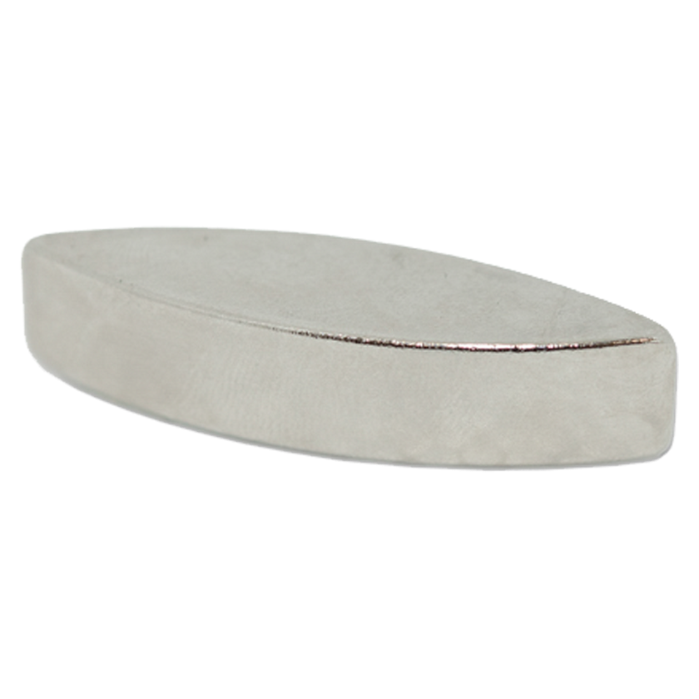
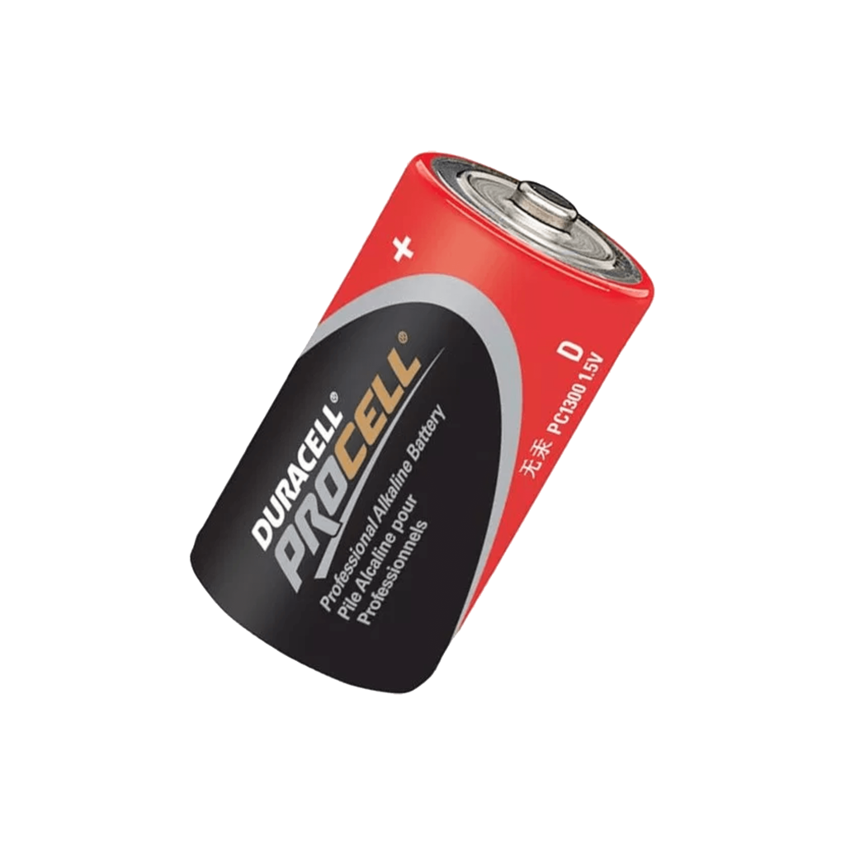
Materials
Magnets
Copper Wire
Battery (D)
Rubber Bands
Paper Clips

Slide 18
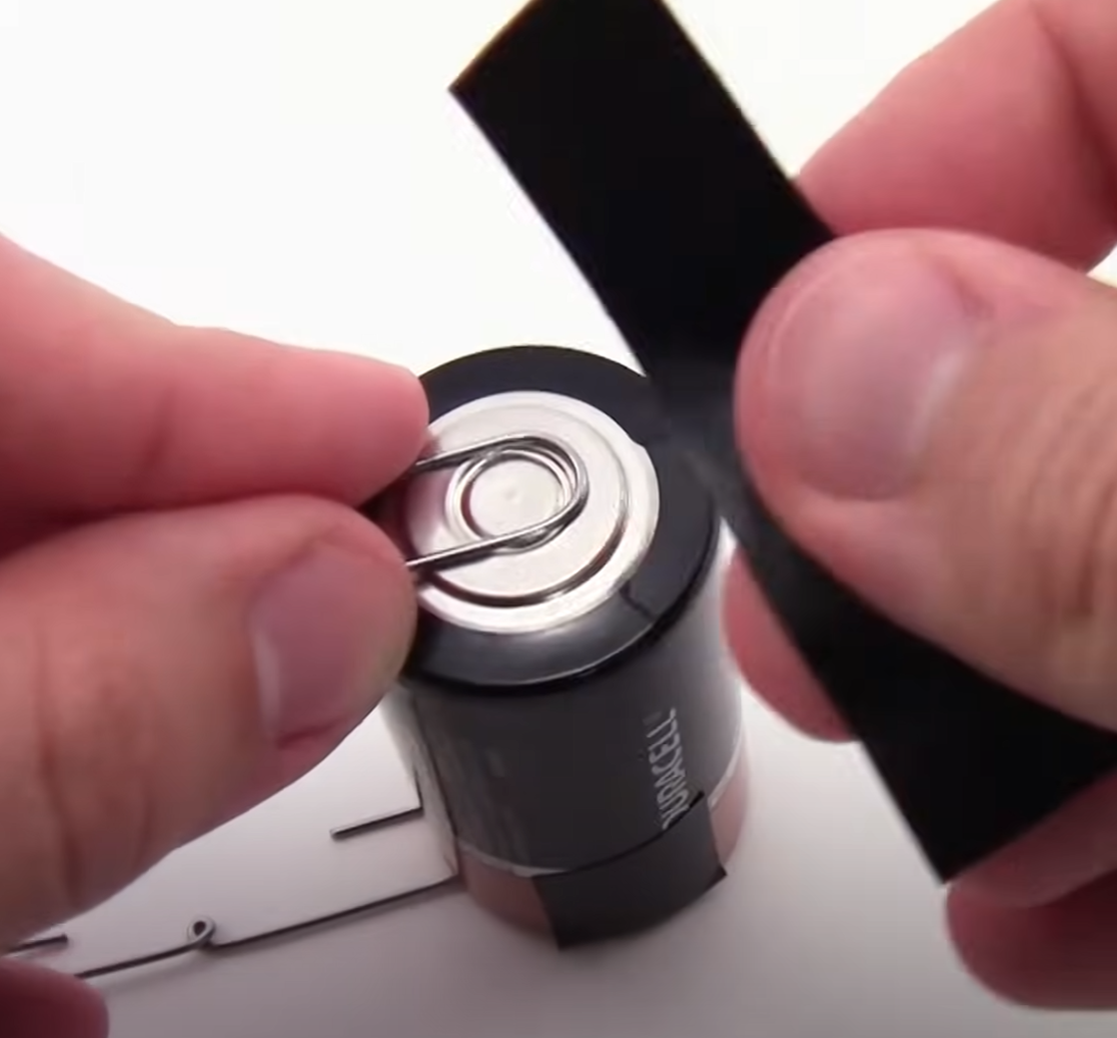
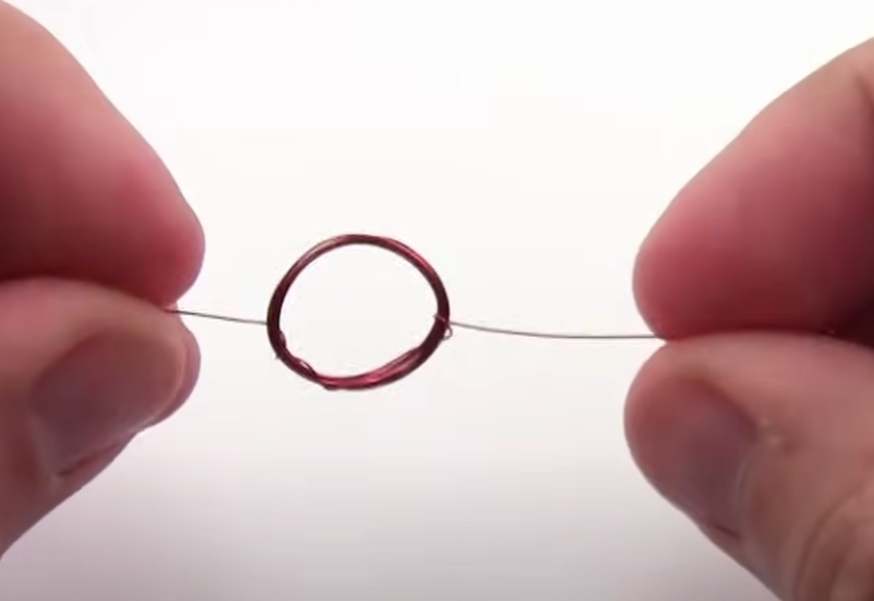
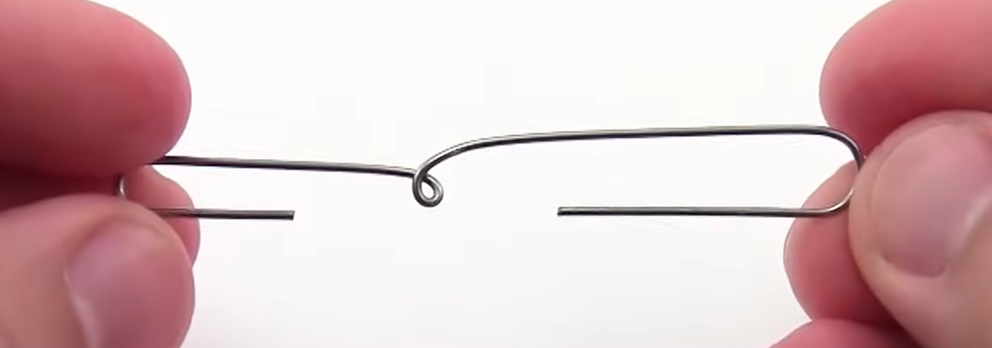
Building
Bend the paper clips
Tape paperclips to both ends of battery
Wrap wire around something circular to make a coil

Slide 19
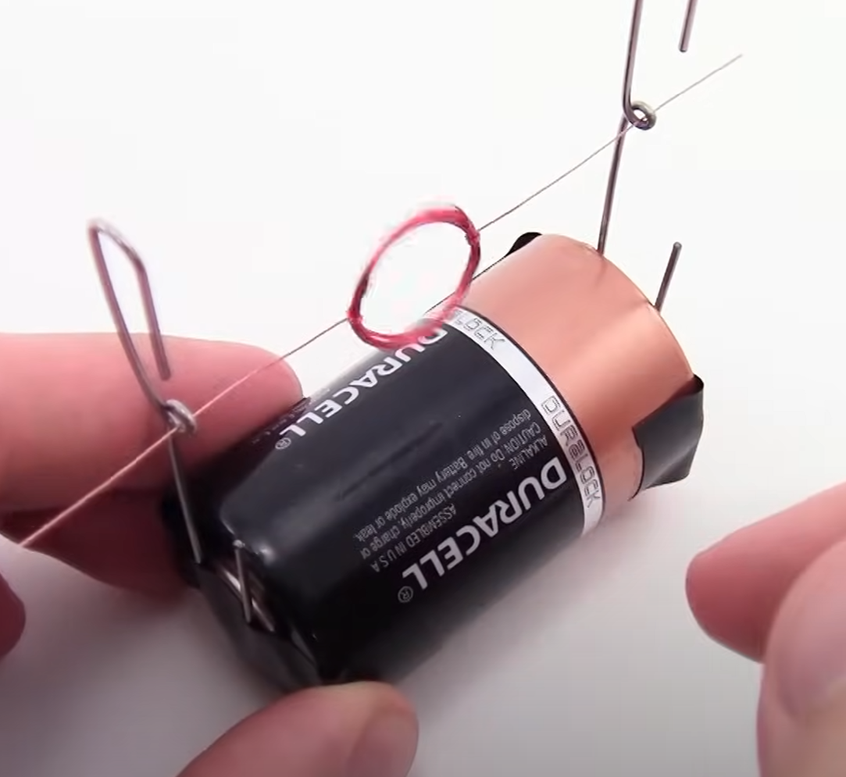
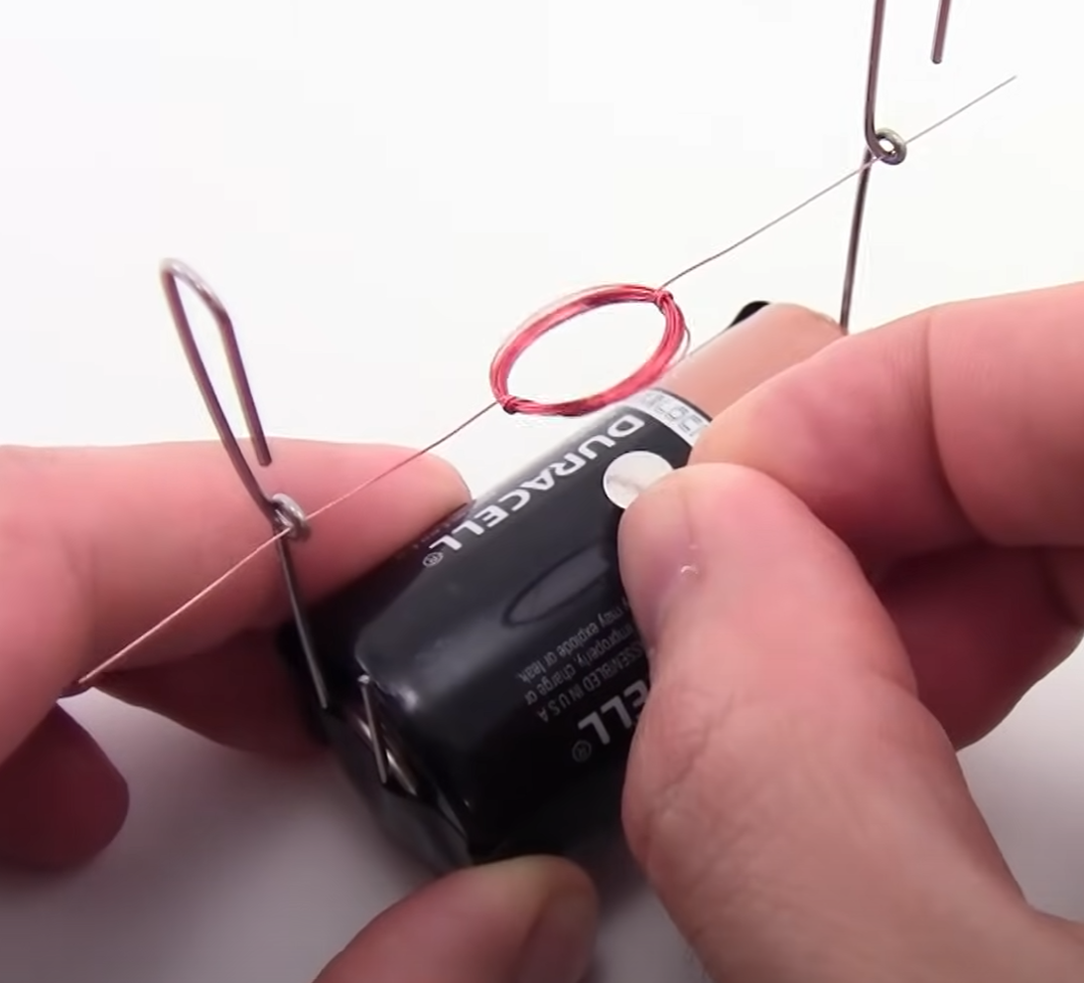
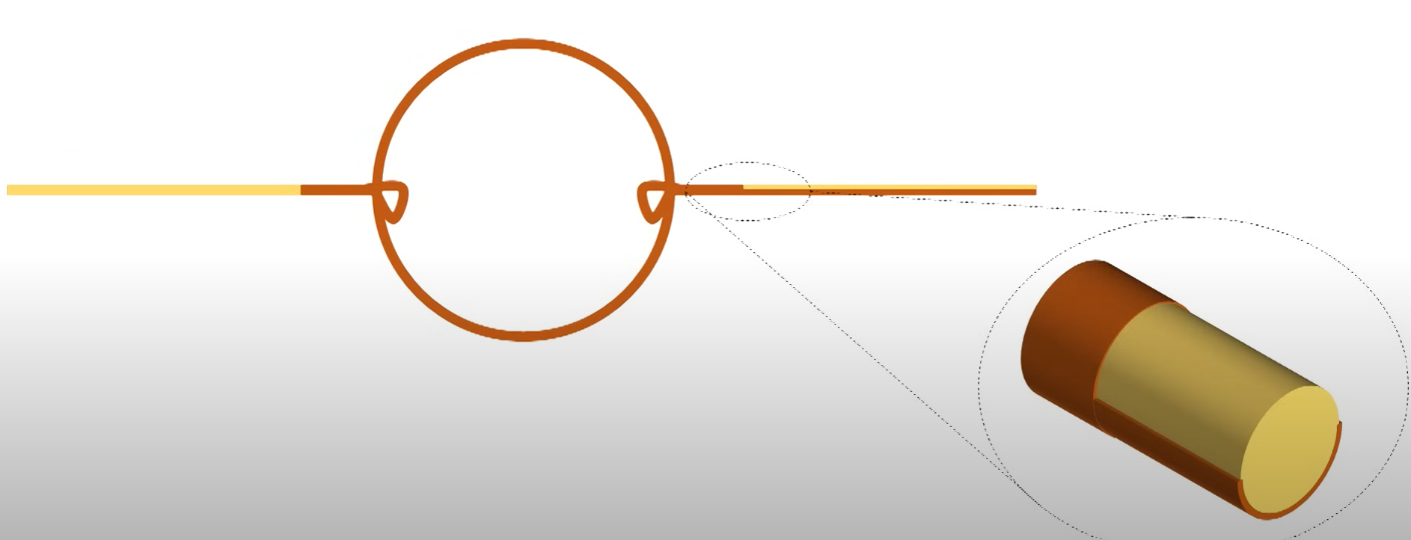
2. Assembly
Strip insulation off of one end of wire. Strip half the insulation off other end of wire
Put wire into paper clips
Put magnet under coil and push!

Slide 20
Explanation
The copper is a temporary magnet. It gets its force from current in the battery
The poles of the permanent magnet repel the poles of the temporary magnet, rotating halfway
Then, the half of wire with insulation breaks the flow of current letting gravity finish the rotation and repeat

Slide 21
Explanation
Why strip one side only halfway?
If current always flows, its pushes will oppose each other making the coil bounce back and forth
If current flows half of the time, all pushes will be in the same direction

